Slide 1
LLM Alignment: Reinforcement Learning through Human Feedback
Plaban Kumar Bhowmick
Department of AI
plaban@ai.iitkgp.ac.in

Slide 2
Resources
Christiano et al., Deep Reinforcement Learning from Human Preferences
https://proceedings.neurips.cc/paper_files/paper/2017/file/d5e2c0adad503c91f91df240d0cd4e49-Paper.pdf
Umar Jamil
RLHF Basics: https://www.youtube.com/watch?v=qGyFrqc34yc
DPO: https://www.youtube.com/watch?v=hvGa5Mba4c8
Nathan Lambert, Reinforcement Learning from Human Feedback
https://arxiv.org/pdf/2504.12501

Slide 3
Language Model
West
0.6
Kerala
0.1
P(_________ | Kharagpur is a town in)
Taj
0.002
Australia
0.0001

Slide 4
LLM: Generating Next Token
Time=0
Where is Kharagpur?
LLM
Kharagpur
Time=1
Where is Kharagpur?Kharagpur
LLM
is
Time=2
Where is Kharagpur?Kharagpur is
LLM
in
Time=3
Where is Kharagpur?Kharagpur is in
LLM
West
Time=4
Where is Kharagpur?Kharagpur is in West
LLM
Bengal

Slide 5
AI Alignment
Tuned model may sometime exhibit undesired behavior
Halucination: Presenting false information
Harmful or offensive response
Misinterpreting human information
AI alignment: LLM fine-tuning to align the model

Slide 6
AI Alignment (HHH)
Helpfulness
The ability of the model to adhere closely to the prompt instructions and help the user accomplish their task
Honesty
The ability of the model to provide accurate information to the user; i.e., to not hallucinate false information
Harmlessness
The model’s tendency to not generate text that is harmful to, or otherwise contrary to, the values and morals of the user

Slide 7
Why Reinforcement Learning?
LLMs lack an intrinsic understanding of nuanced human preferences and societal norms
Humans excel at evaluating and selecting model outputs
Intuitively weigh complex factors like context, cultural nuances, and ethical implications
challenging for automated systems to grasp and incorporate
Traditional loss function to train the language model to align with human preferences through conventional optimization techniques is impractical

Slide 8
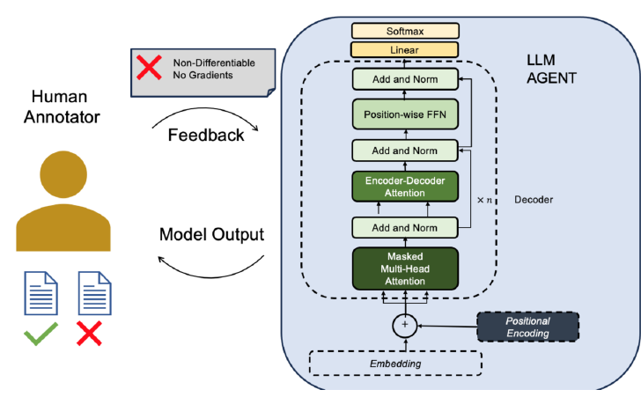
Why Reinforcement Learning?

Slide 9



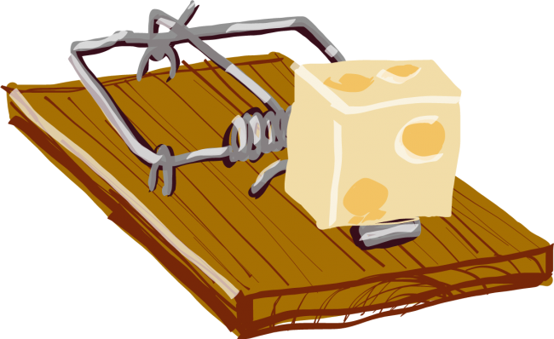
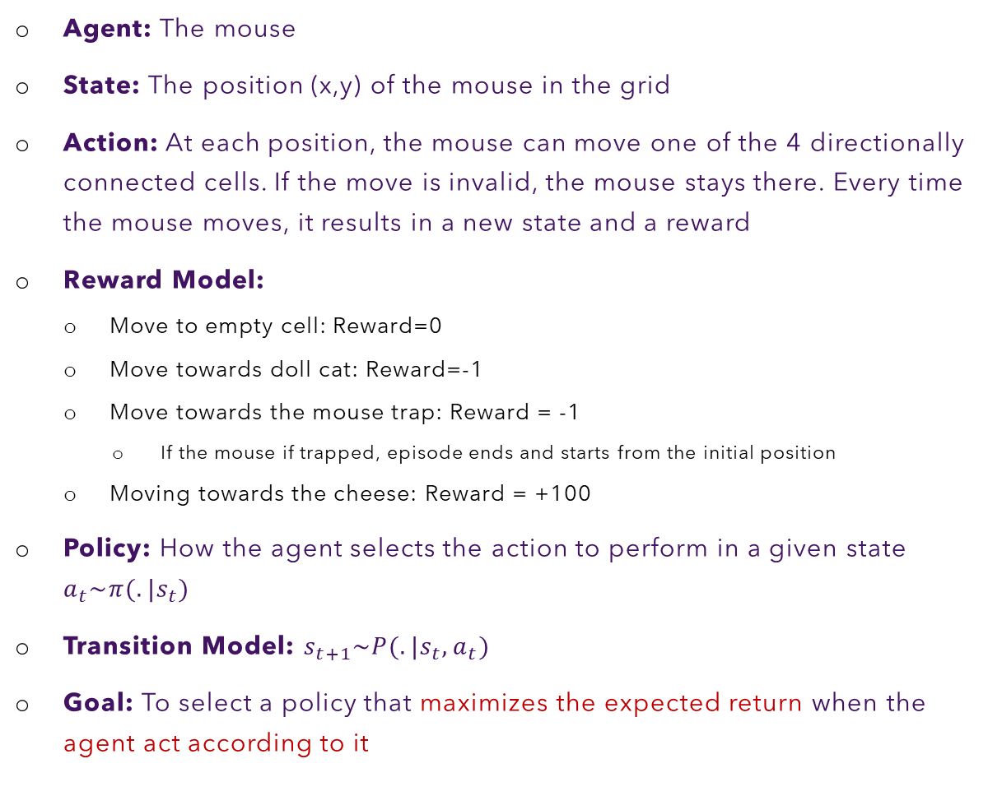
The RL Setup
Agent: The mouse
State: The position (x,y) of the mouse in the grid
Action: At each position, the mouse can move one of the 4 directionally connected cells. If the move is invalid, the mouse stays there. Every time the mouse moves, it results in a new state and a reward
Reward Model:
Move to empty cell: Reward=0
Move towards doll cat: Reward=-1
Move towards the mouse trap: Reward = -1
If the mouse if trapped, episode ends and starts from the initial position
Moving towards the cheese: Reward = +100
Policy: How the agent selects the action to perform in a given state $a_{t}\sim π(.|s_{t})$
Transition Model: $s_{t+1}\sim P(.|s_{t}, a_{t})$
Goal: To select a policy that maximizes the expected return when the agent act according to it

Slide 10
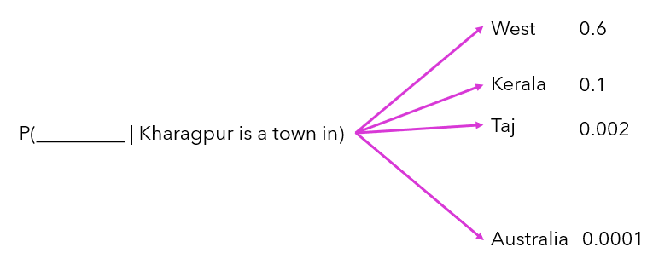
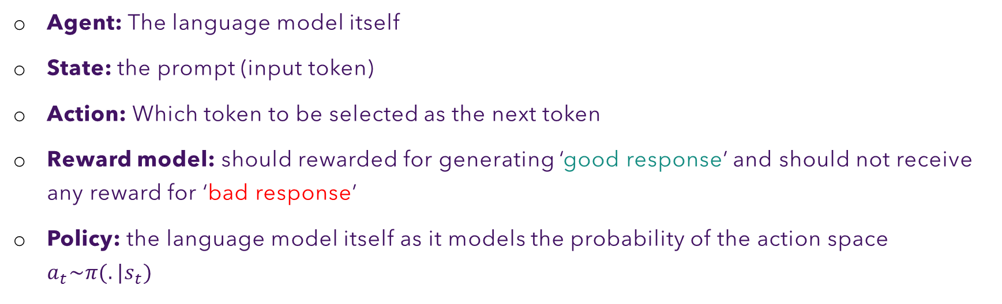

RL and Language Model
Agent: The language model itself
State: the prompt (input token)
Action: Which token to be selected as the next token
Reward model: should rewarded for generating ‘good response’ and should not receive any reward for ‘bad response’
Policy: the language model itself as it models the probability of the action space $a_{t}\sim π(.|s_{t})$
$$a_{t}\sim π(.|s_{t})$$
What is the reward model?
Action
State

Slide 11
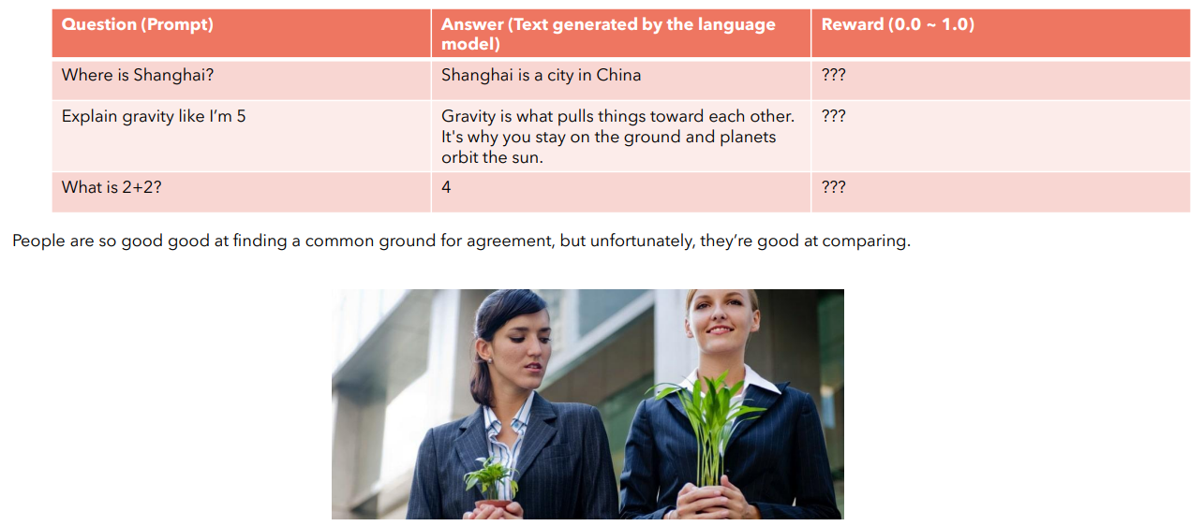
Reward Model for Language Models
It is not easy for us to create the reward model, as this would require us to dataset of prompts and
responses and universally accepted ‘reward’ for each answer

Slide 12
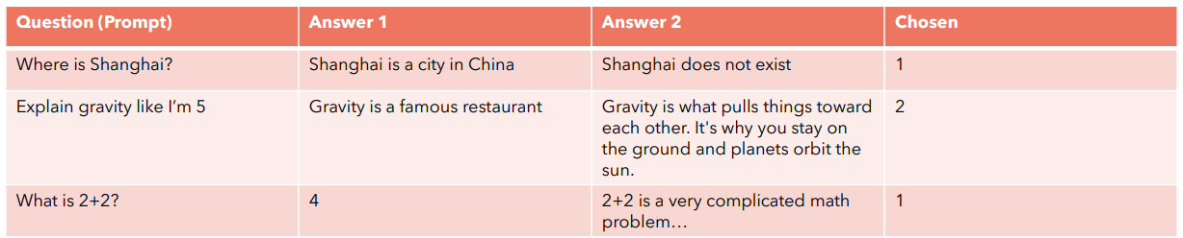
Reward Model by Comparison
Imagine if we could instead create a dataset of queries and answers and we could ask people to just select which one they prefer. This would be much easier!

Slide 13
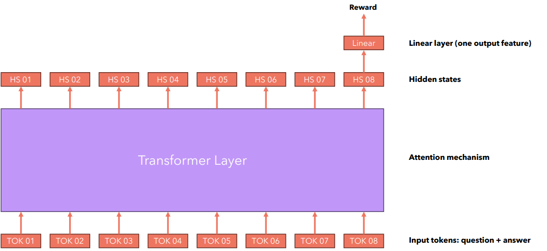
Reward Model Architecture

Slide 14

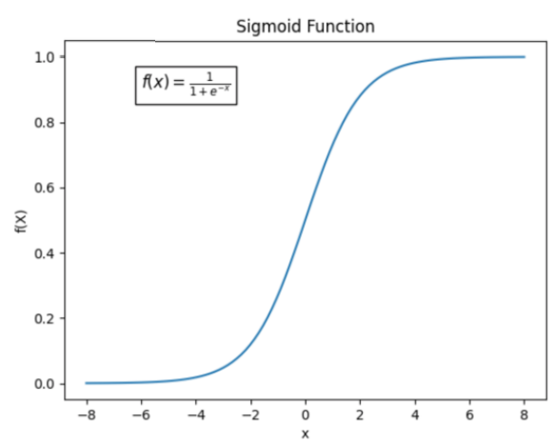
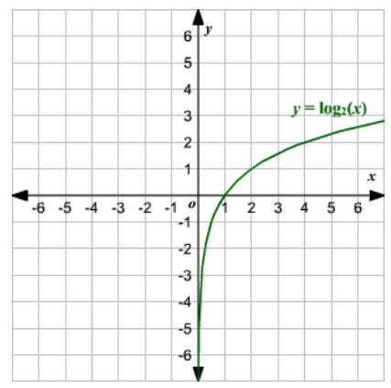

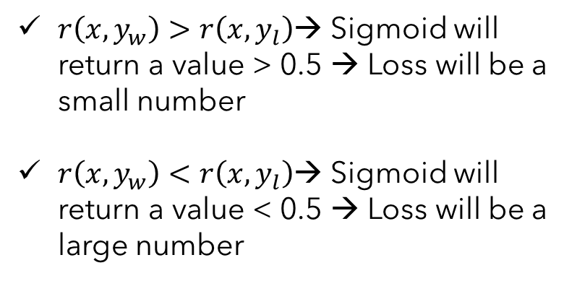

Reward Model: Loss Function
$$r(x,y)$$
$$Loss=−\log{(σ(r\left(x,y_{w}\right)−r\left(x,y_{l}\right)))}$$
$r\left(x,y_{w}\right)>r\left(x,y_{l}\right)$→ Sigmoid will return a value > 0.5 → Loss will be a small number
$r\left(x,y_{w}\right)<r\left(x,y_{l}\right)$→ Sigmoid will return a value < 0.5 → Loss will be a large number
This loss forces the model to give high rewards to “winning” responses and low rewards to “losing” responses, because that’s the only way for the model to minimize the loss.

Slide 15
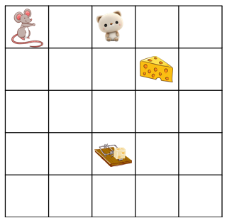
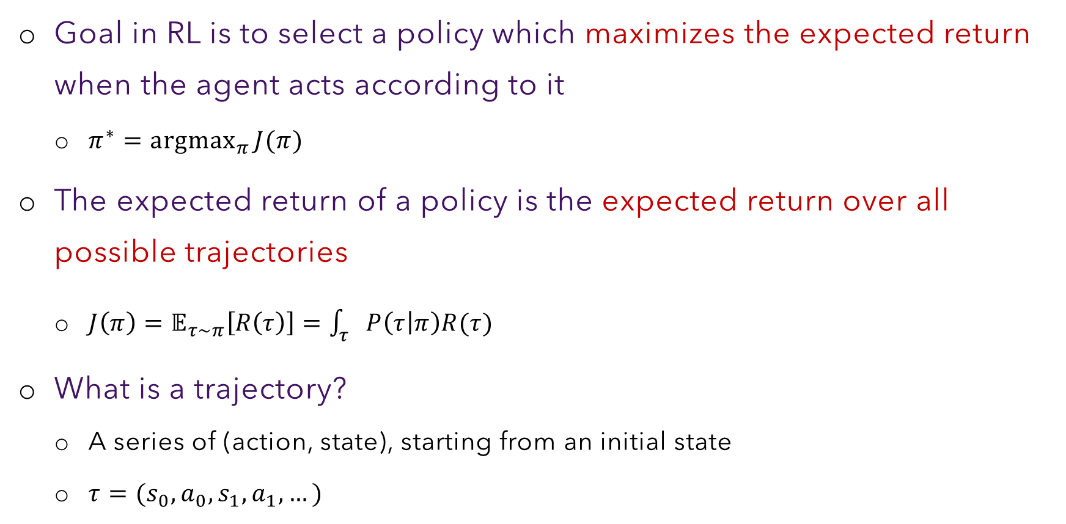
RL: Trajectories
Goal in RL is to select a policy which maximizes the expected return when the agent acts according to it
$π^{∗}=\underset{π}{argmax}{J(π)}$
The expected return of a policy is the expected return over all possible trajectories
$J\left(π\right)=𝔼_{τ\sim π}\left[R\left(τ\right)\right]=\int_{τ}{P\left(τ | π\right)R(τ)}$
What is a trajectory?
A series of (action, state), starting from an initial state
$τ=(s_{0}, a_{0}, s_{1}, a_{1}, …)$

Slide 16
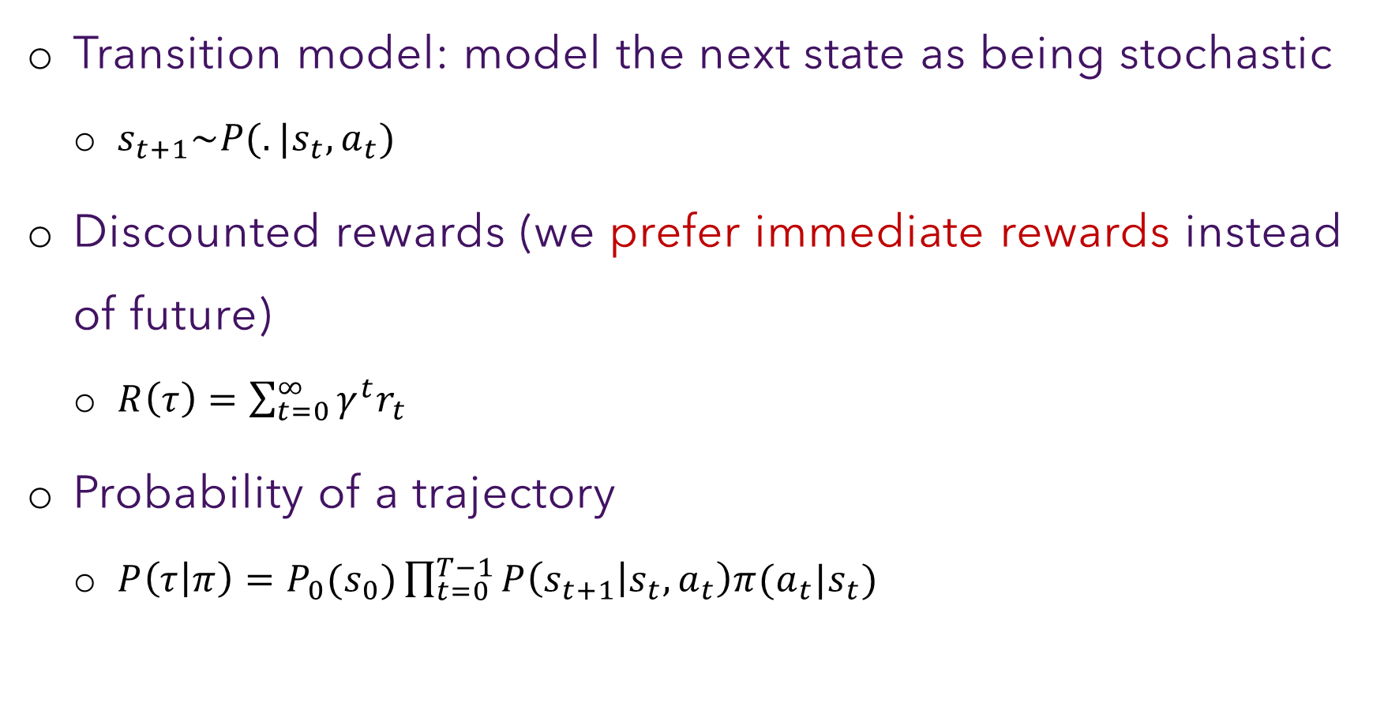
RL: Trajectories
Transition model: model the next state as being stochastic
$s_{t+1}\sim P(.|s_{t}, a_{t})$
Discounted rewards (we prefer immediate rewards instead of future)
$R\left(τ\right)=\sum_{t=0}^{∞}{γ^{t}r_{t}}$
Probability of a trajectory
$P\left(τ | π\right)=P_{0}(s_{0})\prod_{t=0}^{T−1}{P\left(s_{t+1} | s_{t}, a_{t}\right)π(a_{t}|s_{t})}$

Slide 17


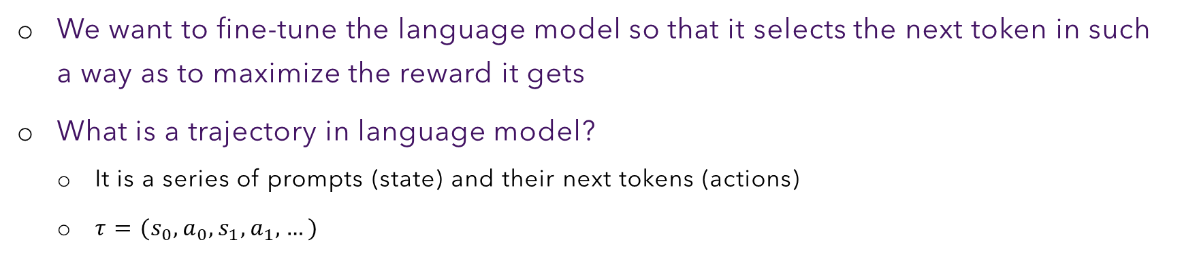
Trajectories in Language Models
We want to fine-tune the language model so that it selects the next token in such a way as to maximize the reward it gets
What is a trajectory in language model?
It is a series of prompts (state) and their next tokens (actions)
$τ=(s_{0}, a_{0}, s_{1}, a_{1}, …)$
Where is Kolkata?
Kolkata
is
in
India

Slide 18
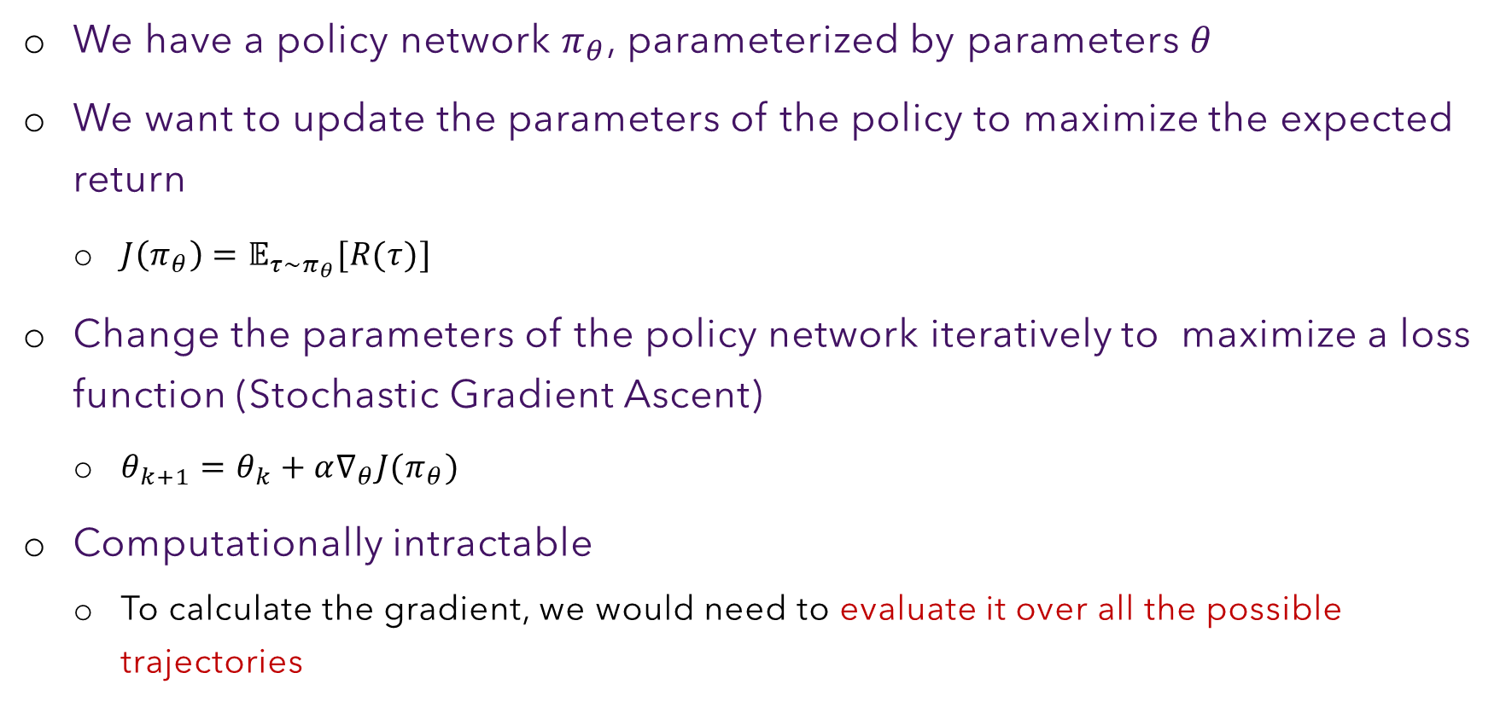
Policy Gradient Optimization
We have a policy network $π_{θ}$, parameterized by parameters $θ$
We want to update the parameters of the policy to maximize the expected return
$J\left(π_{θ}\right)=𝔼_{τ\sim π_{θ}}[R(τ)]$
Change the parameters of the policy network iteratively to maximize a loss function (Stochastic Gradient Ascent)
$θ_{k+1}=θ_{k}+α∇_{θ}J(π_{θ})$
Computationally intractable
To calculate the gradient, we would need to evaluate it over all the possible trajectories

Slide 19




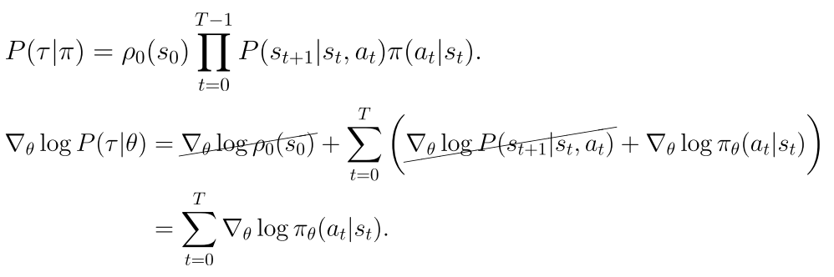

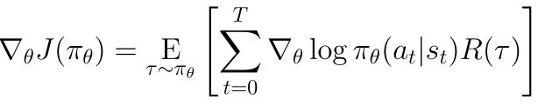


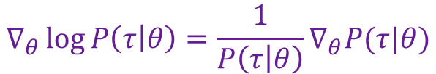
Policy Gradient Optimization
$$∇_{θ}\log{P\left(τ | θ\right)=\frac{1}{P\left(τ | θ\right)}∇_{θ}P(τ|θ)}$$
$$∇_{θ}P\left(τ | θ\right)=P\left(τ | θ\right)∇_{θ}log P(τ|θ)$$
Approximate expectation with sample mean of $𝒟$ trajectories

Slide 20


Policy Gradient Optimization: REINFORCE
Create a neural network that defines a policy
(takes an input the current state of the agent and outputs the probability over the action space)
Use the network to sample trajectories and their corresponding rewards
Use the sample to calculate the gradient
Run stochastic gradient ascent to update the parameters of the policy/network
Go back to 2

Slide 21
Trajectories in LLM
Preference data to train reward model
Trajectory generation
Ask question picked up from the dataset
Generate answer from the LLM
Calculate reward using the reward model
Train the models with the generated trajectory
Text generation
Series of prompt, next token (state, action)

Slide 22





















Trajectory Generation
$$a_{1}$$
$$a_{2}$$
$$a_{3}$$
$$a_{4}$$
Probability of the next action (token)
SOFTM p1
SOFTM p2
SOFTM p3
SOFTM p4
SOFTM p5
SOFTM a1
SOFTM a2
SOFTM a3
Softmax for prob dist
LOGIT p1
LOGIT p2
LOGIT p3
LOGIT p4
LOGIT p5
LOGIT a1
LOGIT a2
LOGIT a3
Linear layer for logit calculation
$${hp}_{1}$$
$${hp}_{2}$$
$${hp}_{3}$$
$${hp}_{4}$$
$$hp_{5}$$
$$ha_{1}$$
$$ha_{2}$$
$$ha_{3}$$
Each hidden state encoder information only about previous tokens (causal masking)
Language Model (Policy $θ$)
$$p_{1}$$
$$p_{2}$$
$$p_{3}$$
$$p_{4}$$
$$p_{5}$$
$$a_{1}$$
$$a_{2}$$
$$a_{3}$$

Slide 23




Reward Calculation
Reward ($t=0$)
Reward ($t=1$)
Reward ($t=2$)
Reward ($t=3$)
Linear layer with one output
Linear
Linear
Linear
Linear
LOGIT p5
LOGIT a1
LOGIT a2
LOGIT a3
$${hp}_{1}$$
$${hp}_{2}$$
$${hp}_{3}$$
$${hp}_{4}$$
$$hp_{5}$$
$$ha_{1}$$
$$ha_{2}$$
$$ha_{3}$$
Language Model (Policy $θ$)
$$p_{1}$$
$$p_{2}$$
$$p_{3}$$
$$p_{4}$$
$$p_{5}$$
$$a_{1}$$
$$a_{2}$$
$$a_{3}$$

Slide 24
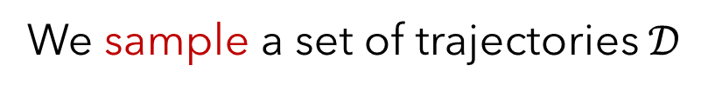
Issues with Gradient Policy Optimization
The gradient is approximated through a sample
(set of trajectories)
We sample a set of trajectories $𝒟$
The approximation is unbiased
On the average, the approximated gradient will
converge to the true gradient
But the gradient has high variance

Slide 25
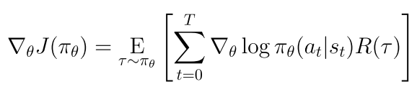
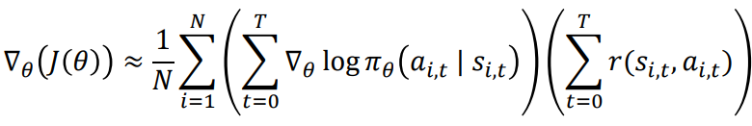
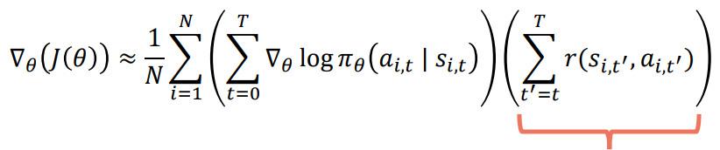
Reducing Variance: Influence of Future
Future cannot influence the past
Reward to go
Removing terms in the expression may reduce variance

Slide 26
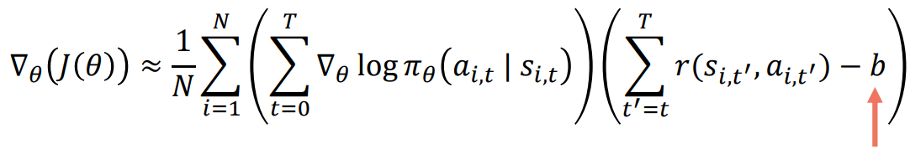

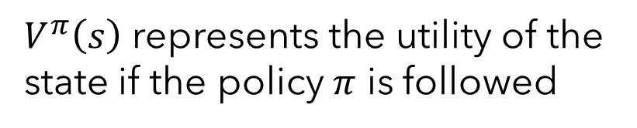

Reducing Variance: Baseline
$b$ can be dependant on the state → Value function ($V^{π}\left(s\right)$)
$$s$$
$V^{π}\left(s\right)$ represents the utility of the state if the policy $π$ is followed

Slide 27








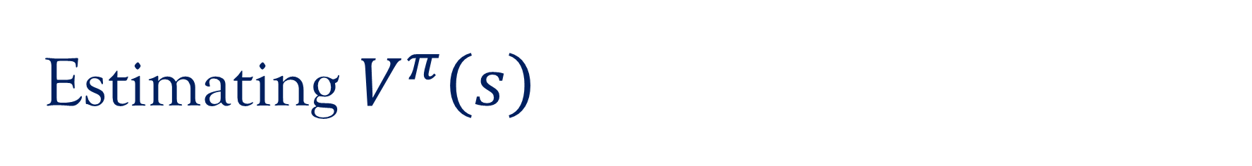













Estimating $V^{π}\left(s\right)$
$$V^{π}(s_{0})$$
$$V^{π}(s_{1})$$
$$V^{π}(s_{2})$$
$$V^{π}(s_{3})$$
Linear layer with one output
Linear
Linear
Linear
Linear
LOGIT p5
LOGIT a1
LOGIT a2
LOGIT a3
Training data: Generate a trajectory and calculate reward at each point
$${hp}_{1}$$
$${hp}_{2}$$
$${hp}_{3}$$
$${hp}_{4}$$
$$hp_{5}$$
$$ha_{1}$$
$$ha_{2}$$
$$ha_{3}$$
Language Model (Policy $θ$)
$$p_{1}$$
$$p_{2}$$
$$p_{3}$$
$$p_{4}$$
$$p_{5}$$
$$a_{1}$$
$$a_{2}$$
$$a_{3}$$

Slide 28
Overall Model Architecture
Language Model
Reward Model
Value Function
LOGIT p5
LOGIT a1
LOGIT a2
LOGIT a3
$${hp}_{1}$$
$${hp}_{2}$$
$${hp}_{3}$$
$${hp}_{4}$$
$$hp_{5}$$
$$ha_{1}$$
$$ha_{2}$$
$$ha_{3}$$
Language Model (Policy $θ$)
$$p_{1}$$
$$p_{2}$$
$$p_{3}$$
$$p_{4}$$
$$p_{5}$$
$$a_{1}$$
$$a_{2}$$
$$a_{3}$$

Slide 29
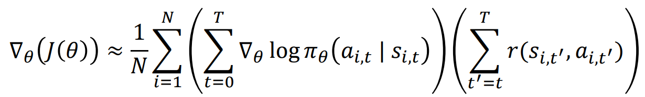
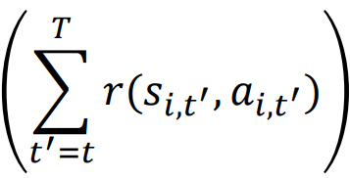





Reducing Variance: Advantage Function
$$s$$
$$P(s^{′}|s,a)$$
$$s_{1}$$
$$s_{1}$$

Slide 30
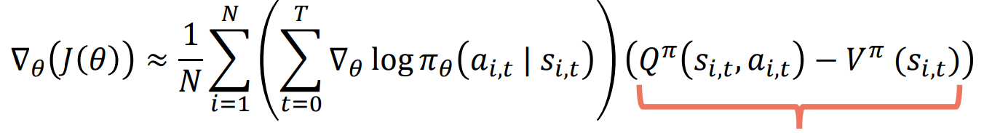
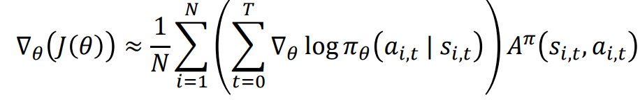
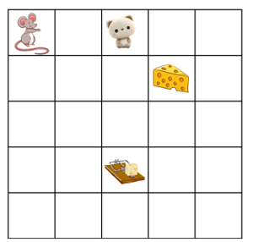
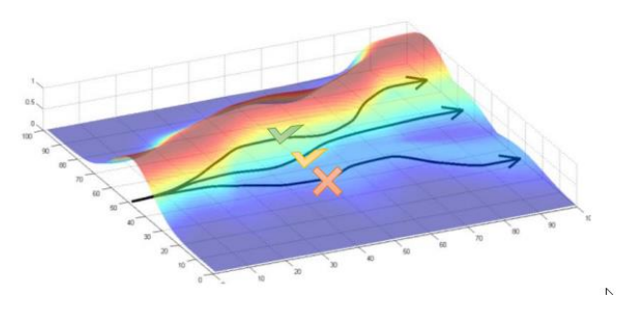
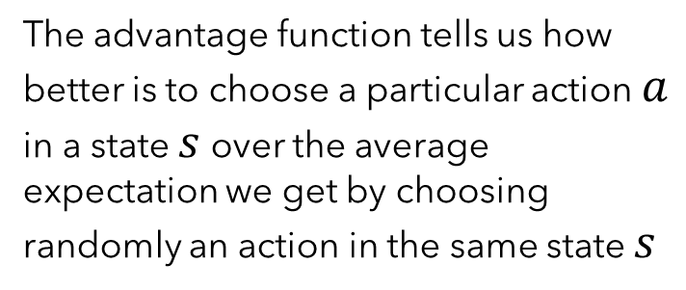
Reducing Variance: Advantage Function
Advantage Function
The advantage function tells us how better is to choose a particular action $a$ in a state $s$ over the average expectation we get by choosing randomly an action in the same state $s$

Slide 31



How to Estimate Advantage?
If we stop too early, we will get a very high bias
If we stop after many terms, we will get high variance

Slide 32



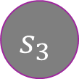
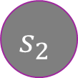


Generalized Advantage Estimation
$$s_{0}$$
$$s_{1}$$
$$s_{2}$$
$$s_{3}$$
$${\hat{A}}_{3}^{π}=δ_{3}+γλ{\hat{A}}_{4}^{π}=δ_{3}$$
$$δ_{3}=r_{3}+γλV^{π}(s_{4})−V^{π}(s_{3})=r_{3}−V^{π}(s_{3})$$
$${\hat{A}}_{2}^{π}=δ_{2}+γλ{\hat{A}}_{3}^{π}={δ_{2}+γλδ}_{3}$$
$$δ_{2}=r_{2}+γλV^{π}(s_{3})−V^{π}(s_{2})$$

Slide 33
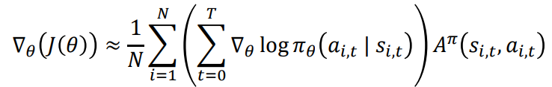
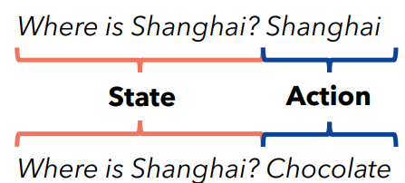
Advantage Term in LM
Language model should be forced to choose tokens that will more likely to lead to future tokens that comply with its reward model
Choosing the next token, given a prompt (state) that in expectation results in “better than average” rewards

Slide 34

Issue with Policy Gradient Optimization
Sample trajectories from the policy network every time we update the parameters
This can be very inefficient!!!

Slide 35

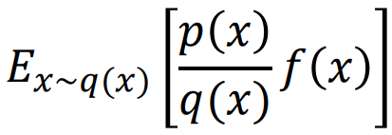
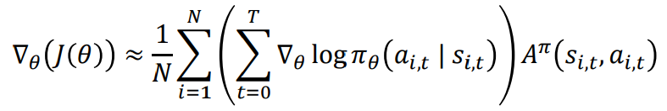
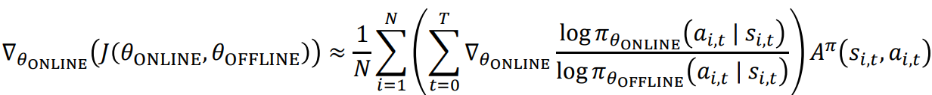


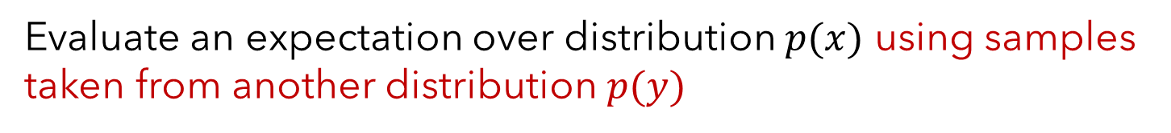
Importance Sampling
Evaluate an expectation over distribution $p(x)$ using samples taken from another distribution $p(y)$
Trajectories sampled from $π_{θ}$
Trajectories sampled from $π_{θ_{OFFLINE}}$

Slide 36
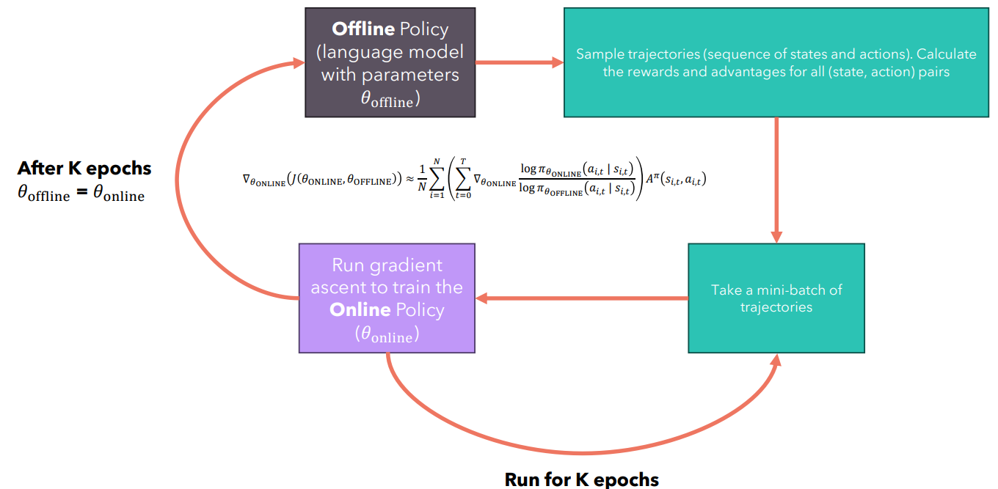
Off-Policy Learning
Not two copies of the policy.
Sample the initial trajectories and then save them in the memory.
Use the saved trajectories to update the model.

Slide 37
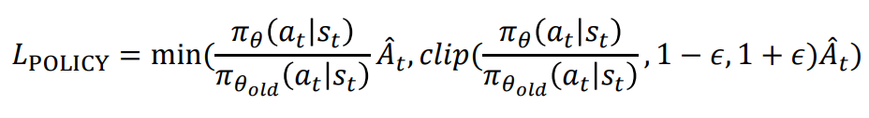
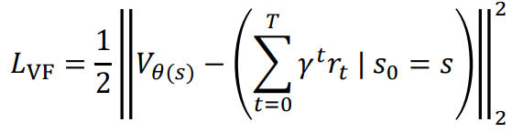



Proximal Policy Optimization (PPO) Loss
Expectation $𝔼_{\sim s_{t}, a_{t}}$
maximize
minimize
maximize

Slide 38
Reward Hacking
Language model (our policy) may just learn to output whatever the reward model wants to see to maximize its return.
Language model to receive good rewards
We want the language model to output something that still looks like the training data
Penalize the (aligned) model if it deviated from the original model
KL divergence between two logit distributions

Slide 39


Reward Hacking
Frozen Model ($θ_{ref}$)
LOGIT
LOGIT
LOGIT
LOGIT
KL Divergence
Reward ($t=0$)
Reward ($t=1$)
Reward ($t=2$)
Reward ($t=3$)
LOGIT p5
LOGIT a1
LOGIT a2
LOGIT a3
$${hp}_{1}$$
$${hp}_{2}$$
$${hp}_{3}$$
$${hp}_{4}$$
$$hp_{5}$$
$$ha_{1}$$
$$ha_{2}$$
$$ha_{3}$$
Language Model (Policy $θ$)
$$p_{1}$$
$$p_{2}$$
$$p_{3}$$
$$p_{4}$$
$$p_{5}$$
$$a_{1}$$
$$a_{2}$$
$$a_{3}$$

Slide 40

Revised PPO Loss
Expectation $𝔼_{\sim s_{t}, a_{t}}$
$$L_{POLICY}=𝔼_{s_{t},a_{t}\sim π_{θ}}\left[\frac{π_{θ}(a_{t}|s_{t})}{π_{θ_{old}}(a_{t}|s_{t})}{\hat{A}}_{t}−βD_{KL}(π_{θ}(.|s_{t})||π_{θ_{ref}}(.|s_{t}))\right]$$
$D_{KL}(π_{θ}(.|s_{t})||π_{θ_{ref}}(.|s_{t}))$: Reward hacking prevention loss

Slide 41
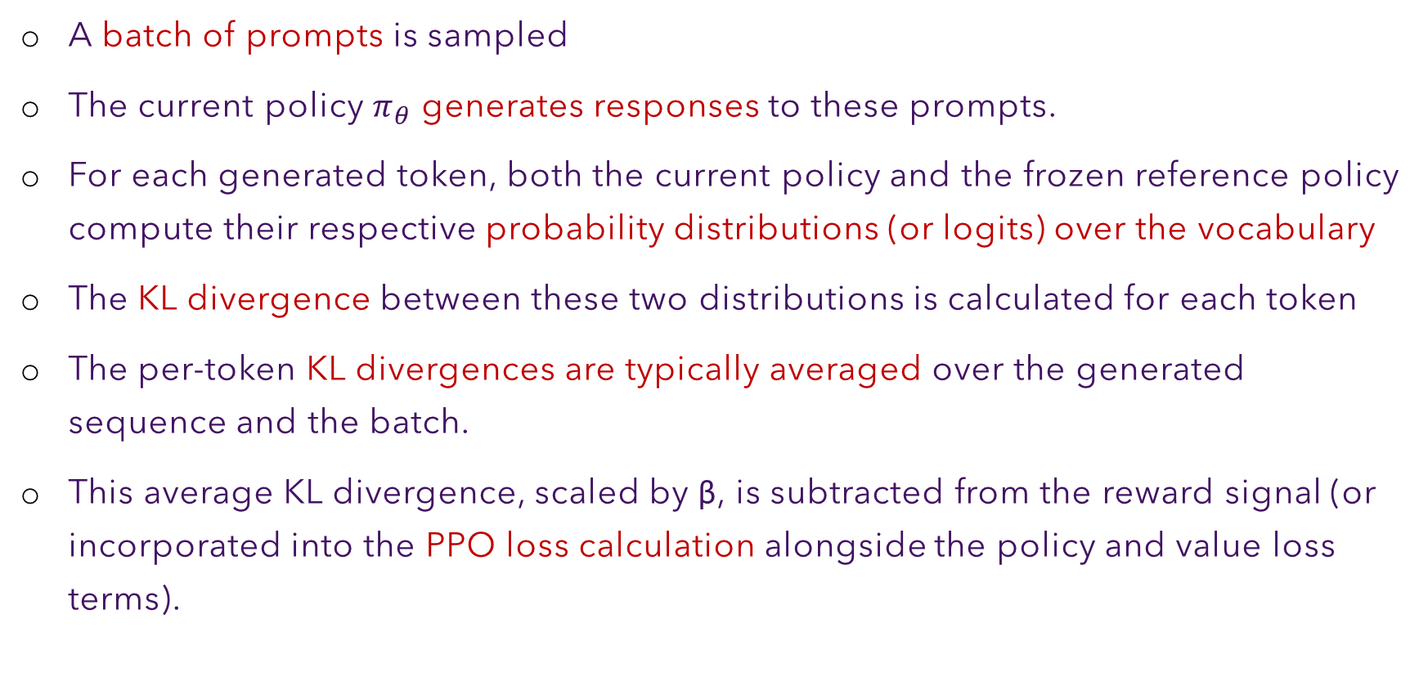
PPO Algorithm
A batch of prompts is sampled
The current policy $π_{θ}$ generates responses to these prompts.
For each generated token, both the current policy ​and the frozen reference policy compute their respective probability distributions (or logits) over the vocabulary
The KL divergence between these two distributions is calculated for each token
The per-token KL divergences are typically averaged over the generated sequence and the batch.
This average KL divergence, scaled by β, is subtracted from the reward signal (or incorporated into the PPO loss calculation alongside the policy and value loss terms).

